Slide 1

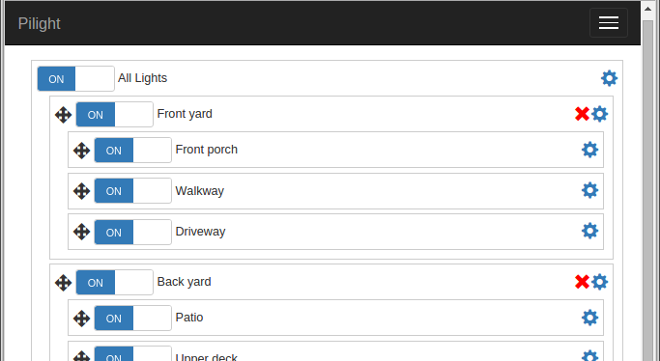

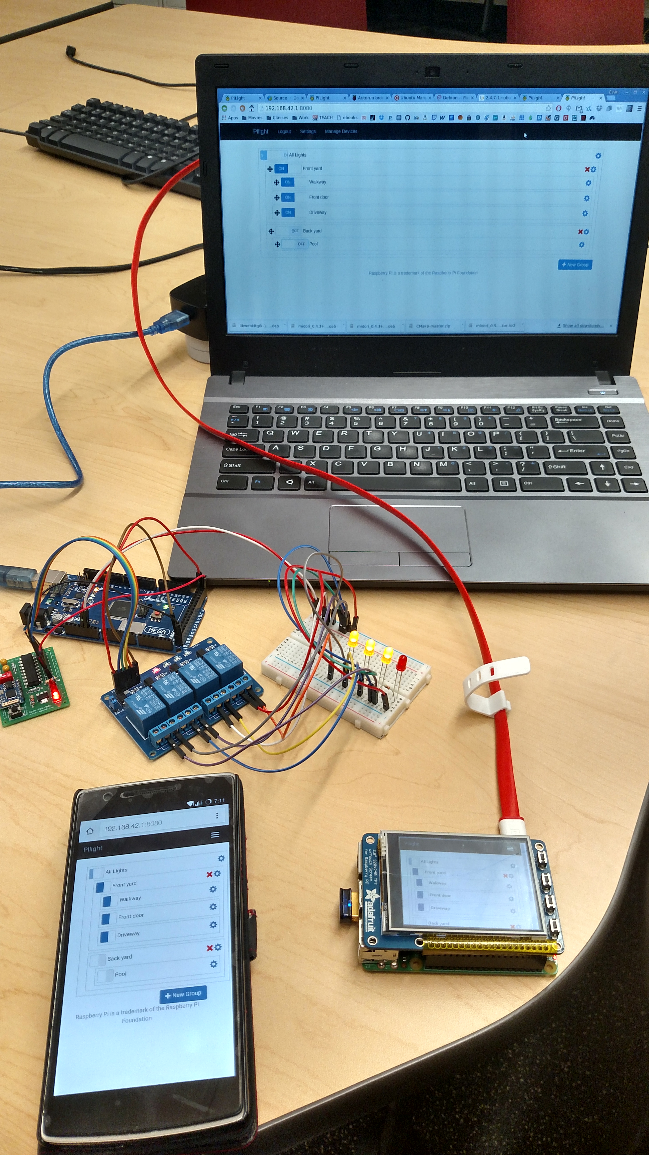
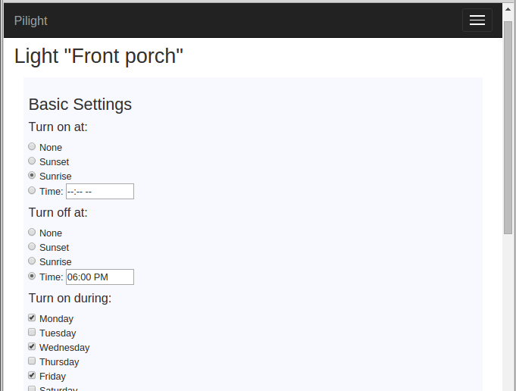
PiLight “Not Exactly the Internet of Things” for Home Lighting
Approach Taken
Our primary goal for the project was ease of use, so we knew having a full-color touch interface for controlling the lights was imperative. Additionally, to negate the need to run wires throughout the house, we designed our devices to communicate wirelessly. Naturally, a central control unit that connects to the light strips via wifi is the way to go. Users can plug their lights into the strips, connect them to power, press the pairing button, and the control unit will pair up and allow users to toggle and program their lights.
PROJECT TEAM 22
Solution Implemented
Plug lights into one or more strips
Connect the light strips to power
Connect the control unit to power and press the “pair” button
All components automatically connect wirelessly
Control unit has touchscreen controls for toggling lights
Control unit can also be controlled from phone, laptop, etc.
Lights can be set to toggle on/off at specified times.
Lights can be set to toggle at sunset/sunrise automatically
Open source software
Inexpensive, easy to use, extensible
TEAM MEMBERS
Malcolm Diller (dillerm@oregonstate.edu)
Sean Rettig (rettigs@oregonstate.edu)
Evan Steele (steelee@oregonstate.edu)
PROJECT ADVISOR
Victor Hsu (hsuv@oregonstate.edu)
PROJECT SPONSOR
OSU
Main interface as seen on a laptop.
Project Description
The options on the market today for home outdoor lighting control are less than ideal. You can either pay out the nose for an overly complex fancy system, or be stuck with a cheap system that needs constant reprogramming for the changing sunset/sunrise times.
Our goal is to split the difference by providing a solution that is both easy to use and affordable. The solution includes a central control unit with touchscreen for controlling lights, a web site for controlling the entire system from a phone, laptop, tablet, or other device, and light strip devices to plug lights into that communicate with the central control unit wirelessly.
Running on commodity hardware and open source software, the system will be easy to extend to other applications as well, such as garage door openers, sprinkler systems, and more!
Solutions Considered
The ESP8266 modules act as clients in our network, connecting to the Raspberry Pi host. The web app supports adding new devices through a pairing system, even with multiple hosts. We considered using an ad-hoc network for connections among other network layouts, but the client-host model proved optimal for our hardware.
We also considered building the web site with PHP, but in the end, decided to go with Python (with Flask) as we were also using it in the ESP modules.
Results and Recommendations
Through various integration tests, we have been able to verify that the interface is functional across all supported devices, including laptops, phones, and the Pi itself (the control unit). Lights can be fully controlled both manually and through the comprehensive rule system that is both easy to use and highly customizable.
Our work has resulted in a low-cost way to implement automation systems for home lighting.
Showing the main interface on a laptop, a phone, and the control unit (Raspberry Pi, lower right). Also shown is the relay (in blue), 4 connected LEDs (right of relay), the ESP8266 (green, left of relay), and an Arduino Mega as a power supply (above relay).
Light automation settings as seen on a laptop.

